Slide 1
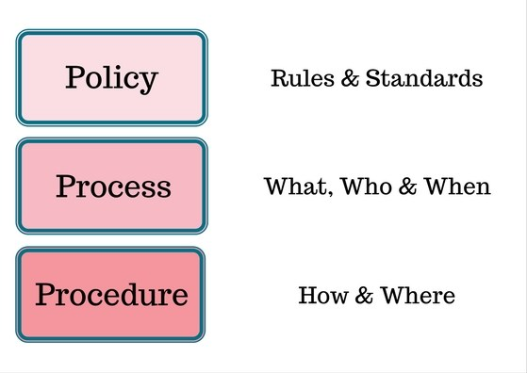
The 3 P’s of IT Delivery

Slide 2
Projects & Work Plans V BAU
A Project or Work Plan can be defined as a temporary endeavour undertaken to create a unique product or service. These are different from other ongoing operations in an organisation, because unlike operations, Projects and Work Plans have a definite beginning and an end - they have a limited duration.

Slide 3
Policy for IT Work Programs and Projects in ICT
Purpose
To deliver a consistent and managed approach to work programs and projects in IT that are approved, budgeted and maintained in a supported environment
Governance
Alignment to strategic plans
Corporate documented process
Principles
Accountability
Consistency
Approved priorities
Customer Focused

Slide 4
Process for IT work Programs and Projects in ICT
Governance
Needs
Delivery
Support
Responsibilities
Identify a
requirement
Work Plan templates
Technical support documentation
Alignment
Create business case
Priority review of workloads
End user documentation
Strategic Deliverables
Expectations
Gain ICT and business approval
Improvement
Create delivery scope document
Tick off procedures
Maintain support and review
Risk

Slide 5
Procedure for IT work Programs and Projects in ICT
Prepare to Start
Governance – Who needs to be involved
doco
Business Case – Why we are doing it and how much it will cost
doco
Prepare to Build
Technical Design Guide – IT design
doco
Prepare to Support
User Documents – this covers both IT and End user in 2 documents
doco
Prepare to Implement
Change Control – Required for change to any production System
doco
Keep Informed
Weekly Work Plans – Required for measuring workload and priorities
doco
Monthly HR review Documents – Tracking YTD for ACR process
doco

Slide 6
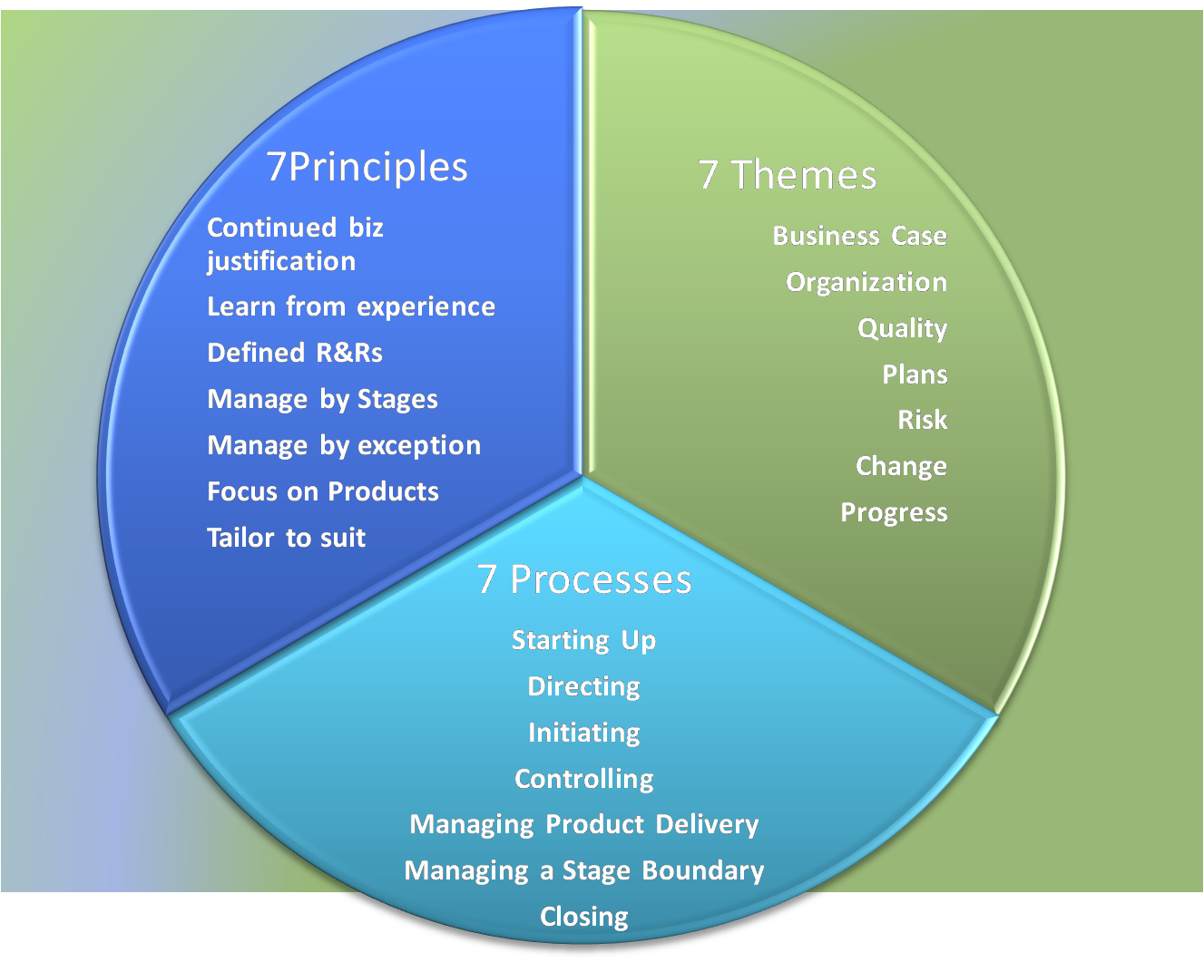
Delivery Based on Methodology

Slide 7
Procurement Alignment
Capex V Opex
>Capex – Over $300 not stock/is a Short term engagements of a vendor/
Capex
> Should be aligned to a Project or Work Program
>Is an Item over >$300 or bundled item but not stock items
> Must have approved Capex
> Must have a p/o to send to a vendor
Opex
> Must have an approves Capex
> Must have a p/o for Items (not ongoing cost)
>P/O field from vendor must say “Workflow” for ongoing costs
>Opex – is an ongoing cost / or is stock

